Slide 1
Predicting the Likelihood of E-Signing a Load Based on Financial History
Meet Shah

Slide 2
Introduction
Lending companies work by analyzing the financial history of their loan applicants and choosing whether the applicant is too risky to be given a loan. If the applicant is not, the company then determines the terms of the loan. To acquire these applicants, companies can organically receive them through their websites/apps, often with the help of advertisement campaigns. Other times, lending companies partner with peer-to-peer (P2P) lending marketplaces, in order to acquire leads of possible applicants. Some example marketplaces include Upstart, Lending Tree and Lending Club. In this project, we are going to assess the ‘quality’ of the leads our company receives from these marketplaces.
Market: The target audience is the set of loan applicants who reached out through an intermediary marketplace.
Product: A loan.
Goal: Develop a model to predict for ‘quality’ applicants. In this case study, ‘quality’ applicants are those who reach a key part of the loan application process.

Slide 3
Business Challenge
In this case study we will be working for a fintech company that specializes on loans. It offers low APR loans to applicants based on their financial habits, as almost all lending companies do. This company has partnered with a P2P lending marketplace that provides real-time leads (loan applicants). The numbers of conversions from these leads are satisfactory.
The company tasks you with creating a model that predicts whether these leads will complete the electronic signature phase of the loan application (a.k.a. e_signed). The company seeks to leverage this model to identify less ‘quality’ applicants (e.g. those who are not responding to the onboarding process), and experiment with giving them different onboarding screens.

Slide 4
Data Explanation
Because the applicants arrived through a marketplace, we have access to their financial data before the onboarding process begins. This data includes personal information like age and time employed as well as other financial metrics. Our company utilizes these financial data points to create risk scores based on many different risk factors.
In this case study, we are given the set scores from algorithms built by the finance and engineering teams. Furthermore, the marketplace itself provides us with their own lead quality scores. We will leverage both sets of scores, as well as small list of personal/financial features to predict if the user is likely to respond to our current onboarding process.

Slide 5
Visualizations
The next set of slides will contain visualizations. Since those visualizations are self-explanatory, there will be only images and no explanations.

Slide 6
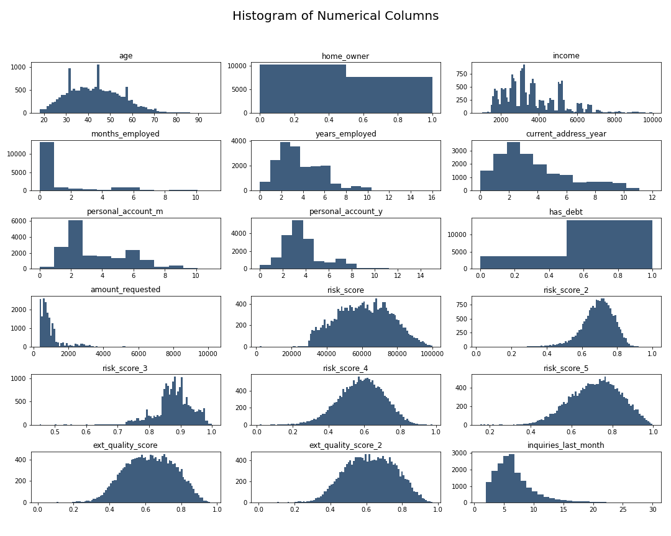

Slide 7
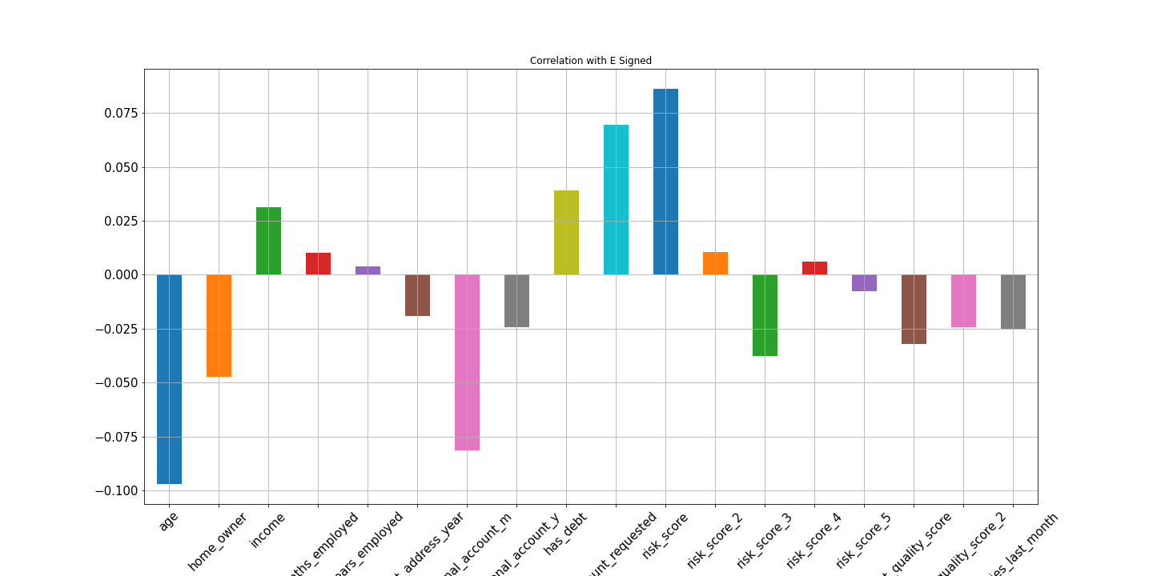

Slide 8
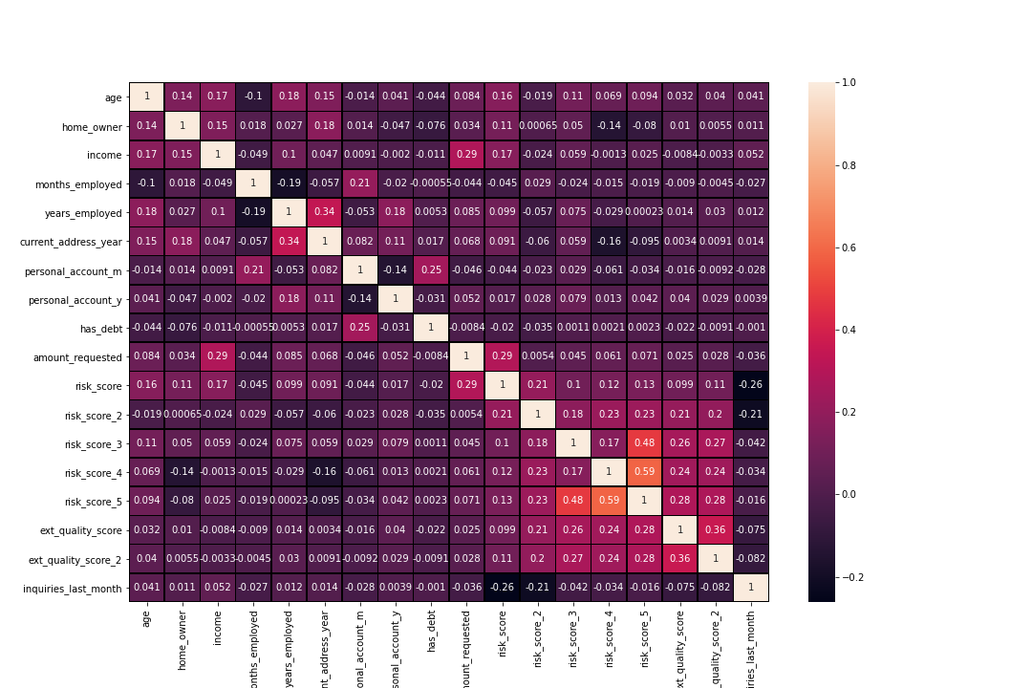

Slide 9
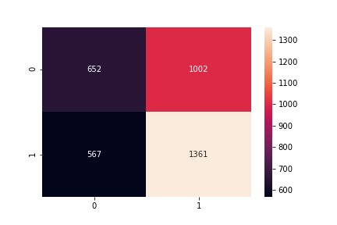
Model Building
Logistic Regression – Confusion Matrix

Slide 10
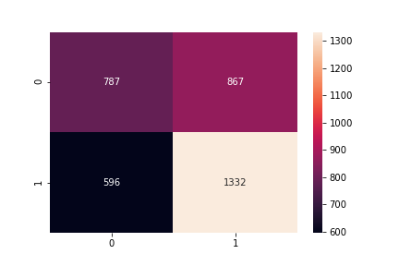
Support Vector Classification – Confusion Matrix

Slide 11
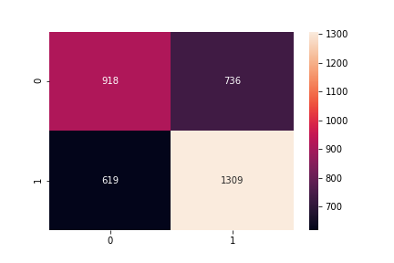
Random Forest – Confusion Matrix

Slide 12
Final Classification Report
Model | Accuracy | Precision | Recall | F1 Score
Linear Regression (Lasso) | 0.561977 | 0.575963 | 0.705913 | 0.634351
SVC (RBF) | 0.591569 | 0.605730 | 0.690871 | 0.645505
Random Forest (n = 100) | 0.621720 | 0.640098 | 0.678942 | 0.658948

Slide 13
Our model has given us an accuracy of around 64%. With this, we have an algorithm that can help predict whether a user will complete the E-Signing step of the loan application. One way to leverage this model is to target those predicted to not reach the e-sign phase with customized onboarding. This means that when a lead arrives from the marketplace, they may receive a different onboarding experience based on how likely they are to finish the general onboarding process. This can help our company minimize how many people drop off from the funnel. This funnel of screens is as effective as we, as a company, build it. Therefore, user drop-off in this funnel falls entirely on our shoulders. So, with new onboarding screens built intentionally to lead users to finalize the loan application, we can attempt to get more than 40% of those predicted to not finish the process to complete the e-sign step. If we can do this, then we can drastically increase profits. Many lending companies provide hundreds of loans every day, gaining money for each one. As a result, if we can increase the number of loan takers, we are increasing profits. All with a simple model!
Conclusion

